Slide 1
- Getting started - Purchase
Tryton By Example
Github - https://github.com/clixwise/tryton-by-example Version of presentation : 6.0 Version of Tryton : 6.0 Verified for execution on : Windows 10 & Powershell 7 Licence : CC BY 4.0 Author : Marc Rottiers

Slide 2
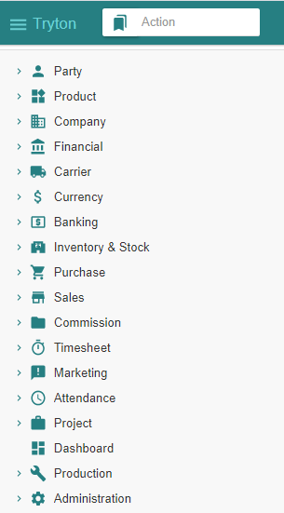
Table of Contents

Slide 3
TOC
MODULE ACTIVATION
Supplier
Product
Inventory & Stock
Purchase
STATE CHANGES
Summary Diagram
PURCHASE PROCESS
Supplier Purchase
Supplier Shipment
Supplier Invoice
Supplier Payment
Activating Supplier-related modules
Activating Product-related modules
Activating Stock-related modules
Activating Purchase-related modules
The state diagram for “Purchase” related operations
Recording a Purchase
Recording a Shipment
Emitting an Invoice
Paying an Invoice

Slide 4
Chart of Accounts (Recap)

Slide 5
Chart of Account
We have installed the « French » chart of accounts : refer to « Basic Functionality » document.
We use the following accounts for the purchase process
Balance Sheet Accounts
Income Statement Accounts
# | French | English
41 | Fournisseur | Supplier
53 | Caisse | Cash
# | French | English
6x | Charge | Expense

Slide 6
Supplier

Slide 7
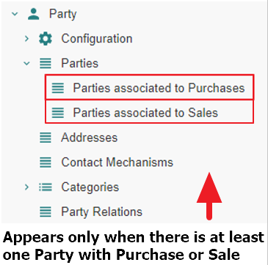
Motivation
Suppliers are named « Parties associated to Purchases ». We name them hereafter « Supplier » for commodity.
Suppliers are in fact party entity roles : any party promotes to a supplier as soon as one or more purchases are linked to it. Same for sales.
Creation : a supplier can be defined by creating an instance with the Menu Tree Item
« Parties » or
« Parties associated to Purchases » if it exists (see Access hereafter).
Access : as long as no purchase is linked to a party, it is not recognized as a supplier and will only be accessible using the Menu Tree Item « Parties ».
Note finally that « Party » modules have been activated as explained in the previous document « Basic Functionality ».

Slide 8
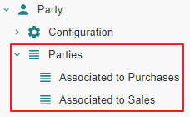
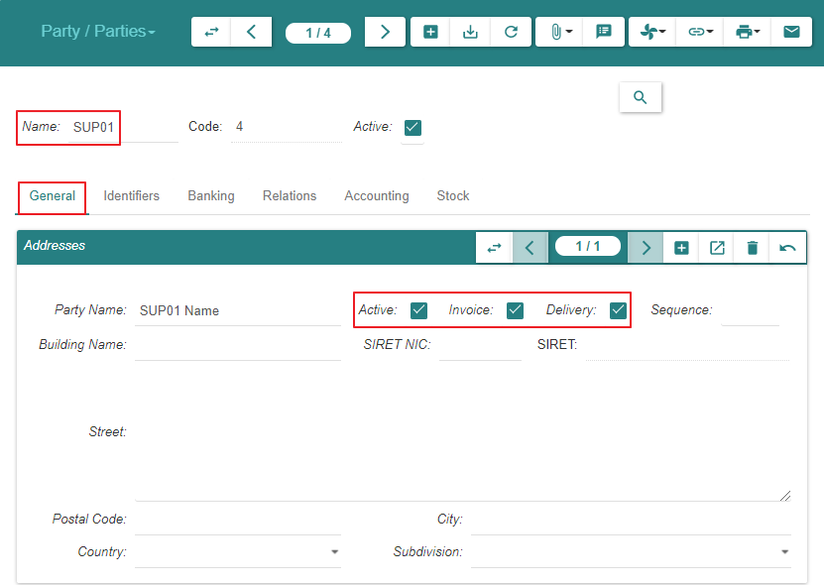
Create

Slide 9
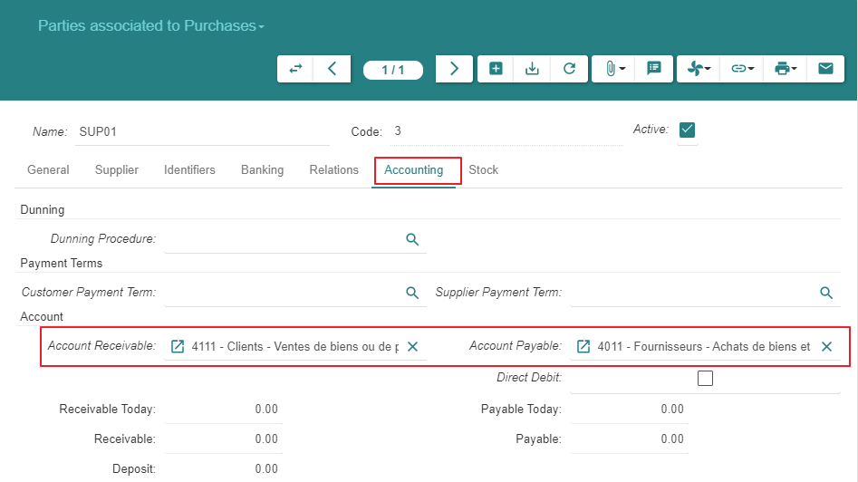
Create

Slide 10
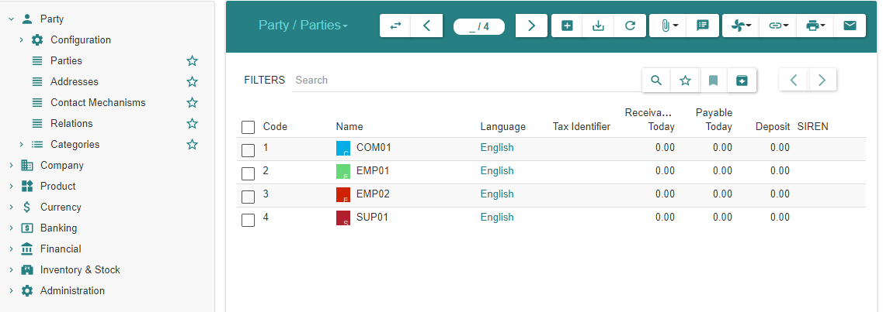
Summary
As explained under « Motivation », the supplier always appears in the list « Parties » above
As long as there are no purchases linked to the supplier, it is absent from « Parties associated to Purchases »
When at least one purchase exists, the supplier appears in both lists

Slide 11
Product

Slide 12
Module Activation

Slide 13
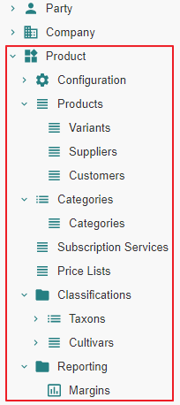
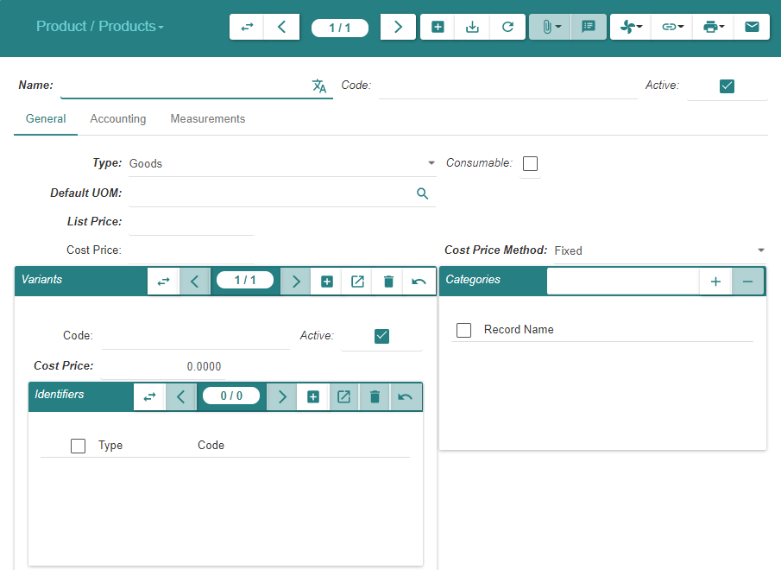
State « Ante »

Slide 14
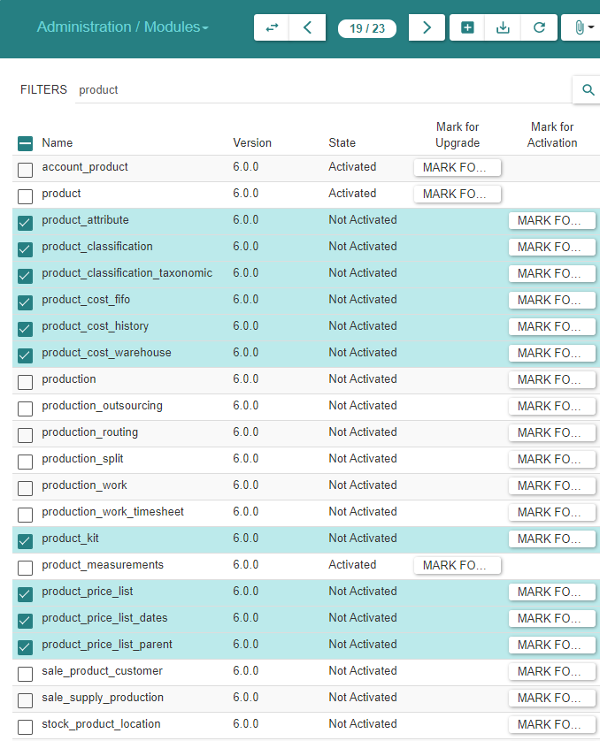
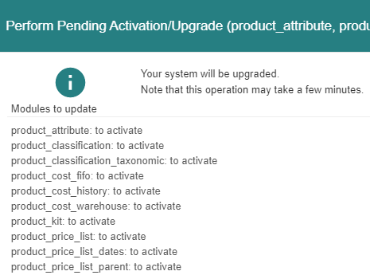
Module Activation

Slide 15
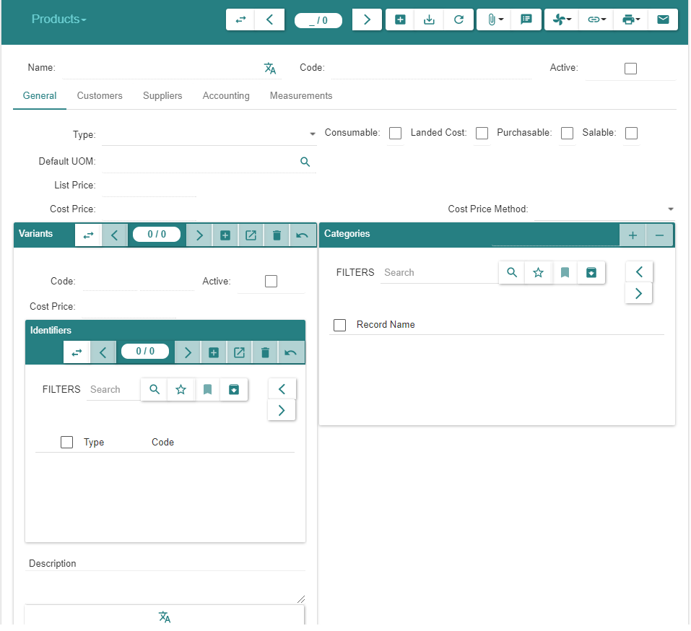
State « Post »

Slide 16
Product & Variant Creation

Slide 17
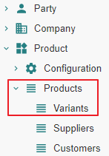
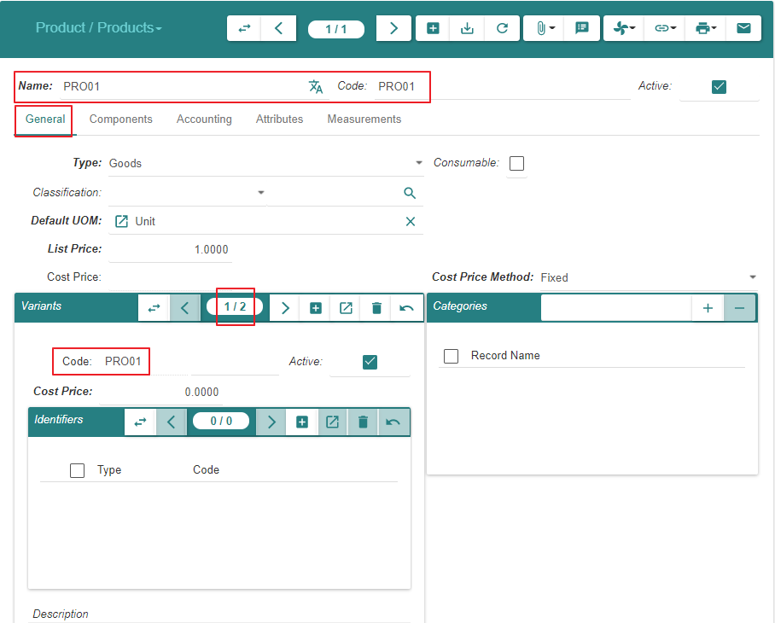
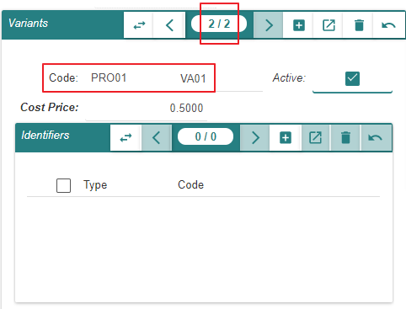
Create « Product PROD01 » & « Variant VA01 »

Slide 18
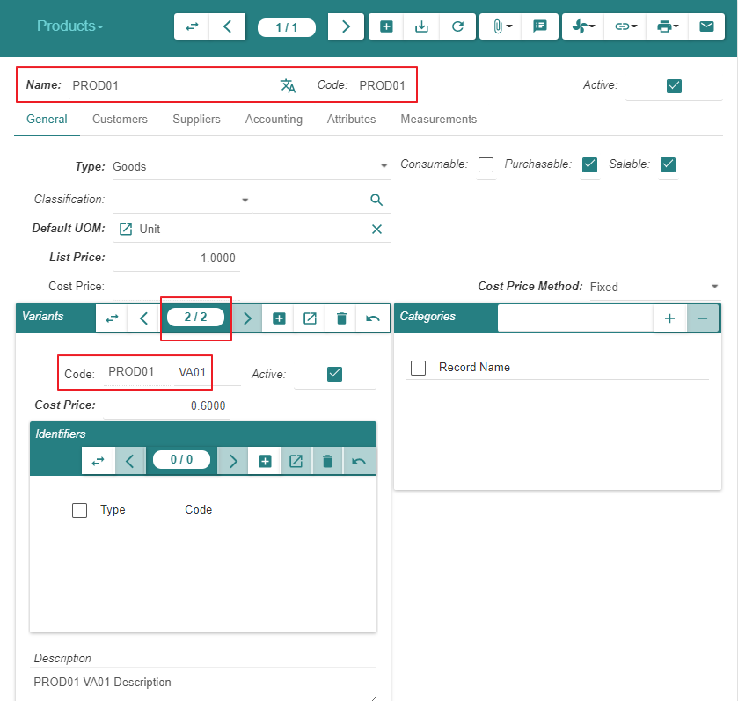
Create « Product PROD01 » & « Variant VA01 »

Slide 19
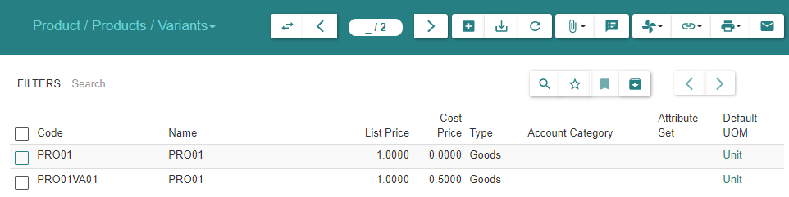
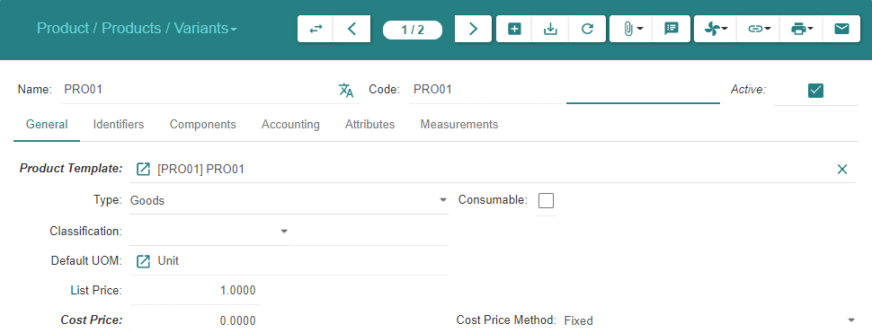
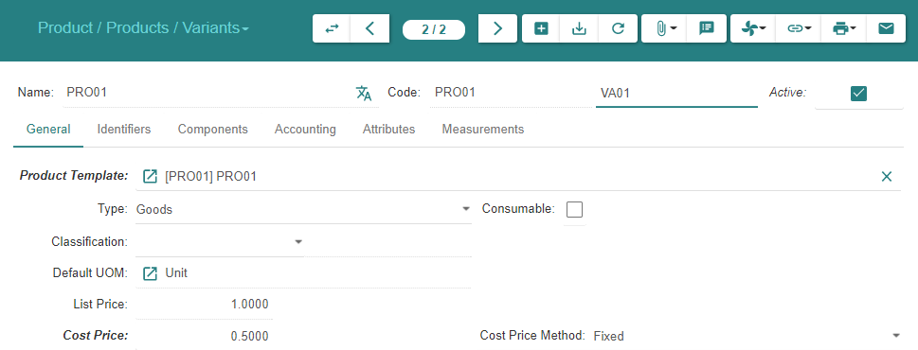
Display « Variants »

Slide 20
Inventory & Stock

Slide 21
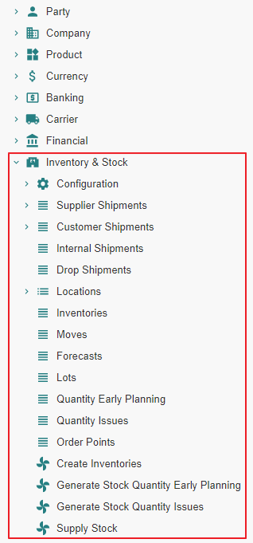
Motivation
We activate all inactive « Inventory & Stock » related modules

Slide 22
Module Activation

Slide 23
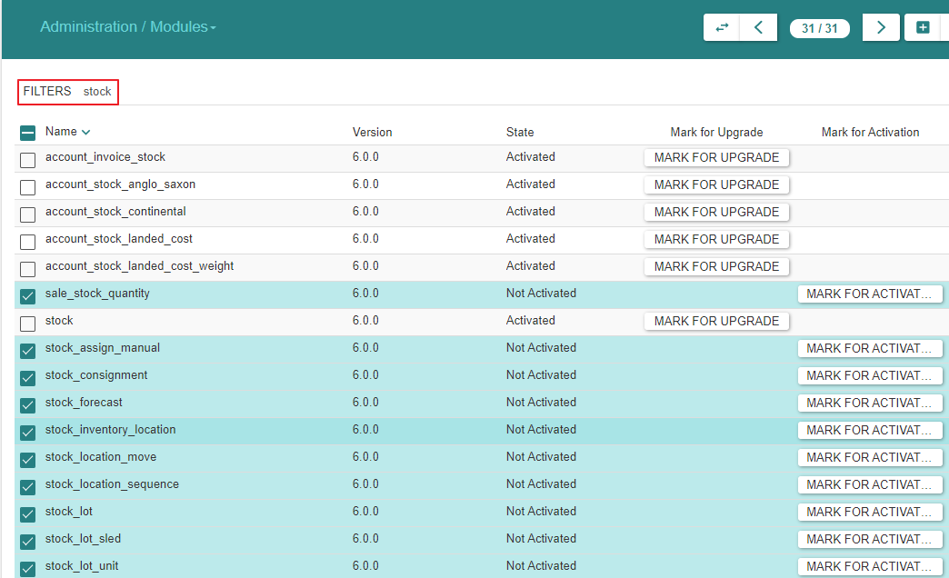
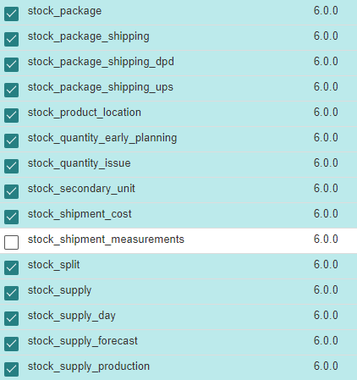
Module Activation

Slide 24
Purchase

Slide 25
Module Activation

Slide 26
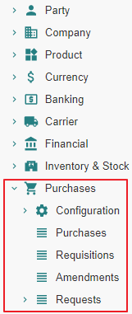
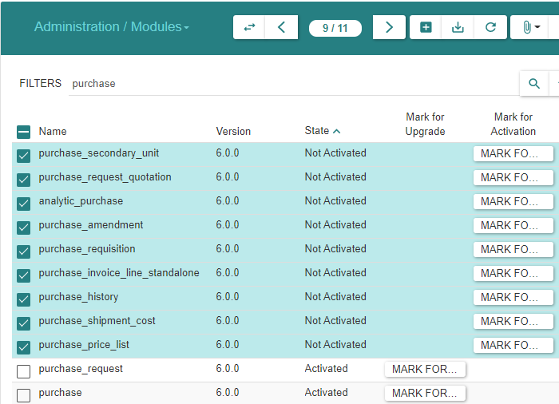
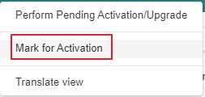
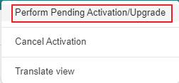
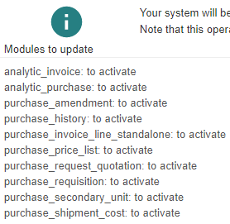
Module Activation

Slide 27
Purchase Configuration

Slide 28
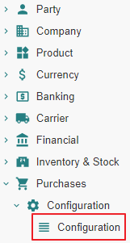
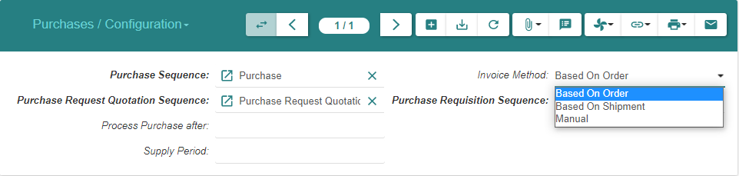
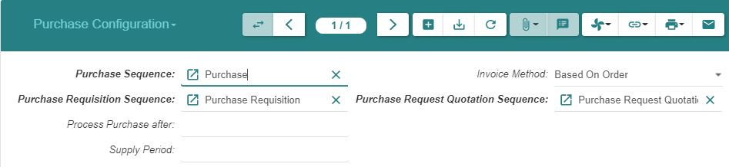
Purchase Configuration (1/2)
Note : The configuration for « Drop Shipment Sequence » will be available later once we activate the « Sale » modules

Slide 29
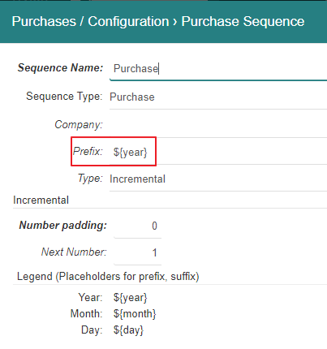
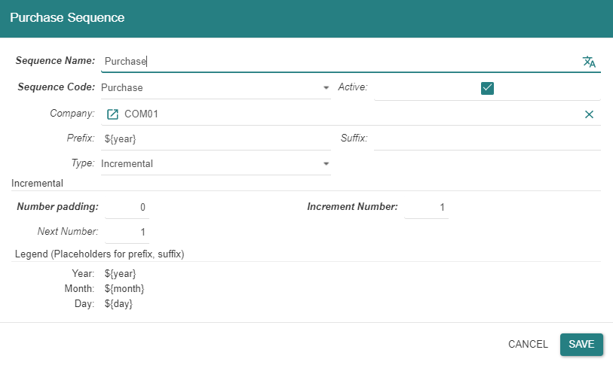
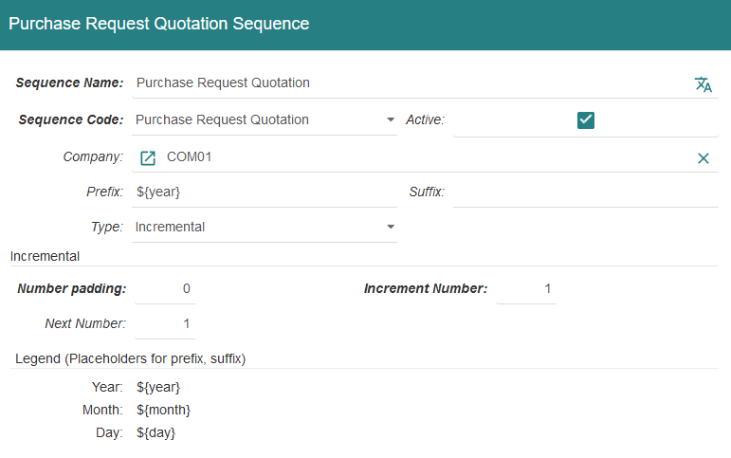
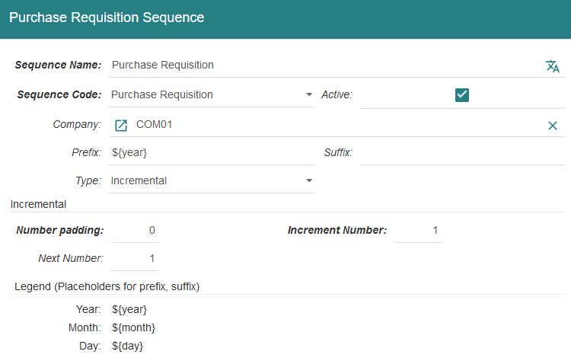
Purchase Configuration (2/2)

Slide 30
Product

Slide 31
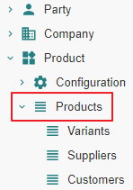
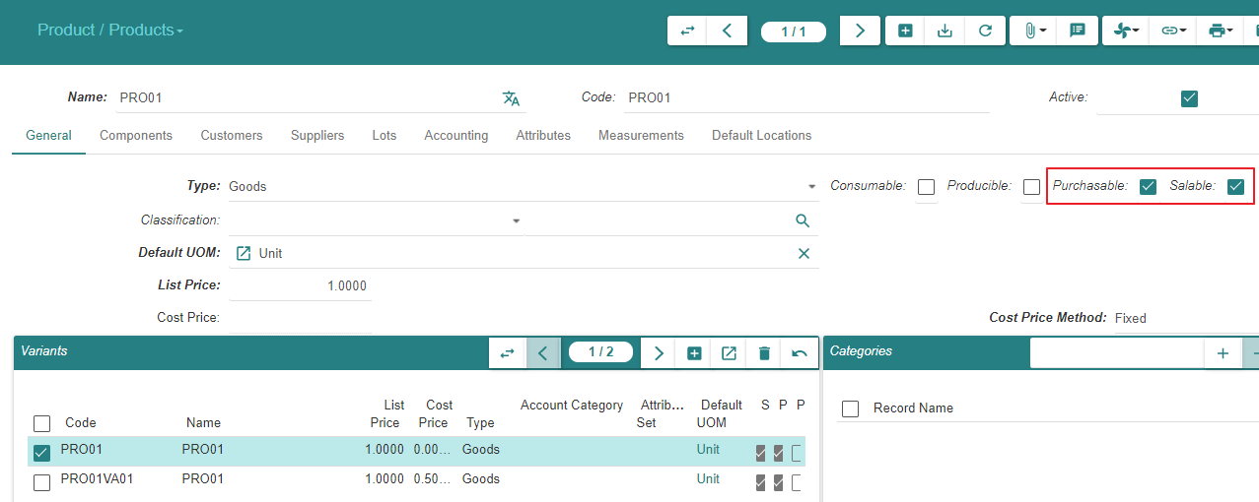
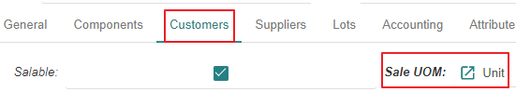
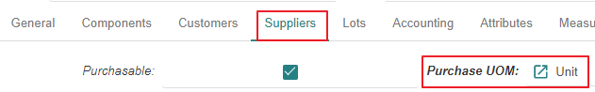
Motivation
We added the « Purchase » functionality to the system
We now declare the « Product » « Purchasable » & « Salable »

Slide 32
Purchase - Related Entities State Changes

Slide 33
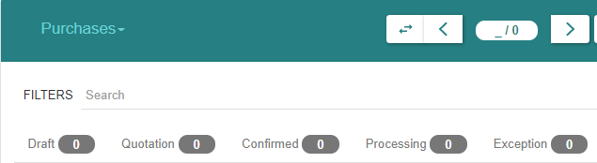
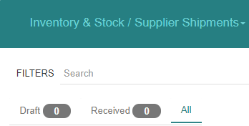
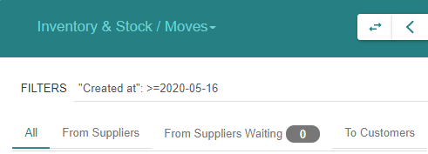
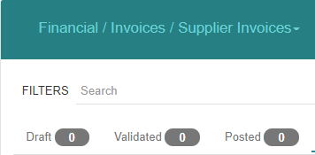
« Purchase » related states

Slide 34
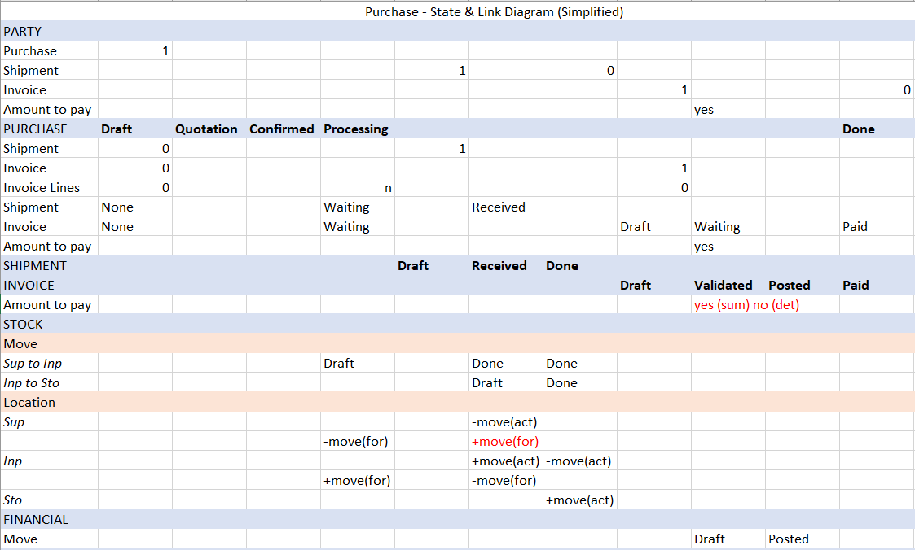
The State Diagram for « Purchases »

Slide 35
Impacted functions

Slide 36
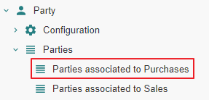
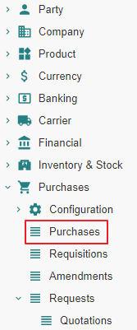
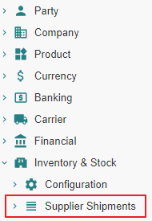
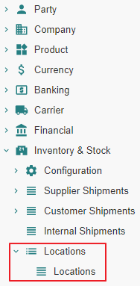
Impact analysis

Slide 37
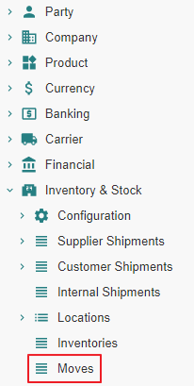
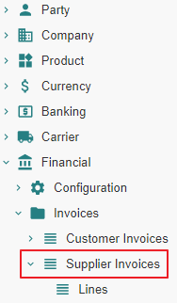
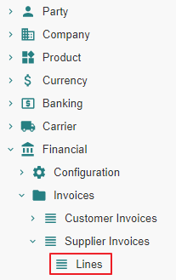
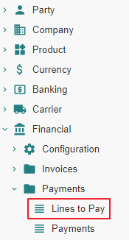
Impact analysis

Slide 38




Impact analysis

Slide 39




Impact analysis

Slide 40
Supplier Purchase - State Changes - Impact Analysis

Slide 41
Purchase From State « Nill » to State « Draft »

Slide 42
Purchase From State « Nill » to State « Draft » Action

Slide 43




Purchase
Purchases are not numbered whilst they are in state « Draft »
Enter « Delivery Date » in order to track « Location Stock Forecast »

Slide 44
Purchase From State « Nill » to State « Draft » Impact

Slide 45
Purchase - From « Nill » To « Draft »
 |  | State | Created - Updated - Deleted -Linked
Supplier
Parties associated to Purchases | 1 |  | Linked to Purchase
Purchase
Purchases (Supplier) | 2 | Draft | Created
Shipment
Supplier Shipments (Supplier) | 3
Stock
Stock Locations | 4
Stock Moves | 5
Invoice
Invoices (Supplier) | 6
Invoice Lines | 7
Payment
Lines to Pay | 8
Payments | 9

Slide 46
Purchase - From « Nill » To « Draft »
 |  | State | Created - Updated - Deleted -Linked
Accounting
Journals - Periods | 10
Account Moves | 11
Open Journal | 12
General Ledger | 13
Balance Sheet | 14
Income Statement | 15
General Journal | 16

Slide 47



1 - Parties associated to Purchases

Slide 48


2 - Purchases | Purchases (SUP01)

Slide 49


10 - Journals - Periods

Slide 50

11 - Account Moves
An « Account Move Line » is created in « State-Draft ». It impacts the General Ledger, the Balance Sheet », the Income Statement, the (Specific, e.g. Expense) Journal, the General Journal.

Slide 51



12 - Open Journal
When an « Account Move Line » is created on a given « Journal » (e.g. « EXP »), it impacts the General Ledger, the Balance Sheet », the Income Statement, the (Specific, e.g. Expense) Journal, the General Journal.

Slide 52


13 - General Ledger

Slide 53

14 - Balance Sheet

Slide 54

15 - Income statement

Slide 55

16 - General Journal

Slide 56



16 - Statements

Slide 57
Purchase From State « Draft » to State « Quotation »

Slide 58
Purchase From State « Draft » to State « Quotation » Action

Slide 59


Purchase
Purchases are numbered when they reach state « Quotation »
Purchases can be returned to state « Draft », e.g. when the price has been renegociated with the « Supplier »

Slide 60
Purchase From State « Draft » to State « Quotation » Impact

Slide 61
Purchase - From « Draft » To « Quotation »
 |  | State | Created - Updated - Deleted -Linked
Supplier
Parties associated to Purchases | 1 |  | Linked to Purchase
Purchase
Purchases (Supplier) | 2 | Quotation | Updated
Shipment
Supplier Shipments (Supplier) | 3
Stock
Stock Locations | 4
Stock Moves | 5
Invoice
Invoices (Supplier) | 6
Invoice Lines | 7
Payment
Lines to Pay | 8
Payments | 9

Slide 62
Purchase - From « Draft » To « Quotation »
 |  | State | Created - Updated - Deleted -Linked
Accounting
Journals - Periods | 10
Account Moves | 11
Open Journal | 12
General Ledger | 13
Balance Sheet | 14
Income Statement | 15
General Journal | 16

Slide 63
1 - Parties associated to Purchases

Slide 64


2 - Purchases | Purchases (SUP01)

Slide 65
Purchase From State « Quotation » to State « Confirmed » or From State « Quotation » to State « Processing »

Slide 66
State transitions
Upon « Confirm » action by the user, a « Sale » or « Purchase » evolves from state « Quotation » to :
State « Confirmed » when a latent purchase processing error condition exists
State « Processing » when such error does not exist.
In the present scenario, the error condition consists in the « Product » not being linked to an « Account Category » and the state transition is from « Quotation » to « Confirmed »
Confirmed
Confirm
-
Purchase Processing related Error Condition Exists
Confirm
-
Purchase Processing related Error Condition Resolved
Confirm
-
Purchase Processing possible
Confirm
Quotation
Processing

Slide 67
Purchase From State « Quotation » to State «Confirmed »

Slide 68
Purchase From State « Quotation » to State «Confirmed » Action

Slide 69

Purchase

Slide 70
Purchase From State « Quotation » to State «Confirmed » Impact

Slide 71
Purchase - From « Quotation » To « Confirmed »
 |  | State | Created - Updated - Deleted -Linked
Supplier
Parties associated to Purchases | 1 |  | Linked to Purchase
Purchase
Purchases (Supplier) | 2 | Confirmed | Updated
Shipment
Supplier Shipments (Supplier) | 3
Stock
Stock Locations | 4
Stock Moves | 5
Invoice
Invoices (Supplier) | 6
Invoice Lines | 7
Payment
Lines to Pay | 8
Payments | 9

Slide 72
Purchase - From « Quotation » To « Confirmed »
 |  | State | Created - Updated - Deleted -Linked
Accounting
Journals - Periods | 10
Account Moves | 11
Open Journal | 12
General Ledger | 13
Balance Sheet | 14
Income Statement | 15
General Journal | 16

Slide 73


2 - Purchases | Purchases (SUP01)

Slide 74
Purchase From State « Confirmed » to State «Processing » Action

Slide 75


Purchase
The button “Process” checks that the purchase order is in a correct state with respect to forthcoming shipment, invoicing and accounting treatment.
In our example, an “Account Category” is missing on the “Product PROD01”

Slide 76


Purchase

Slide 77

Purchase

Slide 78
Purchase From State « Confirmed » to State «Processing » Impact

Slide 79
Purchase - From « Confirmed » To « Processing »
 |  | State | Created - Updated - Deleted -Linked
Supplier
Parties associated to Purchases | 1 |  | Linked to Purchase
Purchase
Purchases (Supplier) | 2 | Processing | Updated
Shipment
Supplier Shipments (Supplier) | 3
Stock
Stock Locations | 4 |  | Created (forecast) [Supplier -= Move ; Input Zone += Move]
Stock Moves | 5 | Draft | Created [Supplier to Input Zone]
Invoice
Invoices (Supplier) | 6
Invoice Lines | 7 |  | Created [Linked to Purchase Line]
Payment
Lines to Pay | 8
Payments | 9

Slide 80
Purchase - From « Confirmed » To « Processing »
 |  | State | Created - Updated - Deleted -Linked
Accounting
Journals - Periods | 10
Account Moves | 11
Open Journal | 12
General Ledger | 13
Balance Sheet | 14
Income Statement | 15
General Journal | 16

Slide 81


2 - Purchases | Purchases (SUP01)

Slide 82



4 - Stock Locations

Slide 83


4 - Stock Locations

Slide 84



5 - Stock Moves
« From Suppliers Waiting » iff « Purchase Delivery Date » exists

Slide 85



7 - Invoice Lines

Slide 86
Supplier Shipment - State Changes - Actual States

Slide 87

Motivation
It is certainly possible to process the shipment(s) pertaining to a « Purchase » using the « Move » menu item.
However, it is recommended to proceed using the « Supplier Shipment » functionality which will manage the following stock moves in a coherent fashion :
« Incoming Moves » between the supplier location and the warehouse input location
« Storage Moves » between the warehouse input location and the warehouse storage location

Slide 88
Supplier Shipment « Nill » To « Draft »

Slide 89
Supplier Shipment From « Nill » To « Draft » Action

Slide 90

Supplier Shipments – Incoming Moves - Using « Added » or « Created »

Slide 91

Supplier Shipments – Incoming Moves - Using « Added »

Slide 92

Supplier Shipments – Incoming Moves - Using « Created » (1/2)

Slide 93


Supplier Shipments – Incoming Moves - Using « Created » (2/2)
Using « Created », it is possible to fine tune « Product », « Quantity », « Unit Price »

Slide 94

Supplier Shipments – Inventory Moves

Slide 95
Supplier Shipment From « Nill » To « Draft » Impact

Slide 96
Supplier Shipment - From « Nill » To « Draft »
 |  | State | Created - Updated - Deleted -Linked
Supplier
Parties associated to Purchases | 1 |  | Linked to Purchase ; Linked to Shipment
Purchase
Purchases (Supplier) | 2 | Processing | Updated ; Linked to Shipment
Shipment
Supplier Shipments (Supplier) | 3 | Draft | Created
Stock
Stock Locations | 4 |  | Created (forecast) [Supplier -= Move ; Input Zone += Move]
Stock Moves | 5 | Draft | Created [Supplier to Input Zone]
Invoice
Invoices (Supplier) | 6
Invoice Lines | 7 |  | Created [Linked to Purchase Line]
Payment
Lines to Pay | 8
Payments | 9

Slide 97
Supplier Shipment - From « Nill » To « Draft »
 |  | State | Created - Updated - Deleted -Linked
Accounting
Journals - Periods | 10
Account Moves | 11
Open Journal | 12
General Ledger | 13
Balance Sheet | 14
Income Statement | 15
General Journal | 16

Slide 98

1 Parties associated to Purchases

Slide 99


2 - Purchases | Purchases (SUP01)

Slide 100


3 - Supplier Shipments | Supplier Shipments (SUP01)

Slide 101
Supplier Shipment « Draft » To « Received »

Slide 102
Supplier Shipment From « Draft » To « Received » Action

Slide 103

Supplier Shipments - Incoming Moves

Slide 104

Supplier Shipments - Inventory Moves

Slide 105
Supplier Shipment From « Draft » To « Received » Impact

Slide 106
Supplier Shipment - From « Draft » To « Received »
 |  | State | Created - Updated - Deleted -Linked
Supplier
Parties associated to Purchases | 1 |  | Linked to Purchase ; Linked to Shipment
Purchase
Purchases (Supplier) | 2 | Processing | Updated ; Linked to Shipment
Shipment
Supplier Shipments (Supplier) | 3 | Received | Updated
Stock
Stock Locations | 4 |  | Created (actual) [Supplier -= Move ; Input Zone += Move]
Stock Moves | 5 | Done [Supplier to Input] ; Draft [Input to Storage] | Updated [Supplier to Input] ; Created [Input to Storage]
Invoice
Invoices (Supplier) | 6
Invoice Lines | 7 |  | Created [Linked to Purchase Line]
Payment
Lines to Pay | 8
Payments | 9

Slide 107
Supplier Shipment - From « Draft » To « Received »
 |  | State | Created - Updated - Deleted -Linked
Accounting
Journals - Periods | 10
Account Moves | 11
Open Journal | 12
General Ledger | 13
Balance Sheet | 14
Income Statement | 15
General Journal | 16

Slide 108


2 - Purchases | Purchases (SUP01)

Slide 109

3 - Supplier Shipments | Supplier Shipments (SUP01)

Slide 110

4 - Stock Locations
« Supplier Forecast Quantity » remains « -5 », should be « 0 »

Slide 111

4 - Stock Locations

Slide 112

5 - Stock Moves

Slide 113
Supplier Shipment From « Received » to « Done »

Slide 114
Supplier Shipment From « Received » To « Done » Action

Slide 115

Supplier Shipments

Slide 116

Supplier Shipments

Slide 117

Supplier Shipments

Slide 118
Supplier Shipment From « Received » To « Done » Impact

Slide 119
Supplier Shipment - From « Received » To « Done »
 |  | State | Created - Updated - Deleted -Linked
Supplier
Parties associated to Purchases | 1 | Updated | Linked to Purchase
Purchase
Purchases (Supplier) | 2 | Processing | Updated ; Linked to Shipment
Shipment
Supplier Shipments (Supplier) | 3 | Done | Updated
Stock
Stock Locations | 4 |  | Updated [Input -= Move ; Storage += Move]
Stock Moves | 5 | Done [Input to Storage] | Updated [Input to Storage]
Invoice
Invoices (Supplier) | 6
Invoice Lines | 7 |  | Created [Linked to Purchase Line]
Payment
Lines to Pay | 8
Payments | 9

Slide 120
Supplier Shipment - From « Received » To « Done »
 |  | State | Created - Updated - Deleted -Linked
Accounting
Journals - Periods | 10
Account Moves | 11
Open Journal | 12
General Ledger | 13
Balance Sheet | 14
Income Statement | 15
General Journal | 16

Slide 121

1 - Parties associated to Purchases

Slide 122


2 - Purchases | Purchases (SUP01)
Note : The « Shipment » information appears to be different depending on the linked-by entity :
From the viewpoint « Supplier », there is no « Shipment » linked-to anymore
From the viewpoint « Purchase » there is still a « Shipment » linked-to

Slide 123



3 - Supplier Shipments | Supplier Shipments (SUP01)

Slide 124

4 - Stock Locations

Slide 125

4 - Stock Locations

Slide 126


4 - Stock Locations

Slide 127

5 - Stock Moves

Slide 128
Supplier Invoice - State Changes - Actual States

Slide 129
Supplier Invoices From State « Nill » to State « Draft »

Slide 130
Supplier Invoices From State « Nill » to State « Draft » Action

Slide 131

Supplier Invoices (1/3)

Slide 132

Supplier Invoices (2/3)

Slide 133

Supplier Invoices (3/3)

Slide 134


Supplier Invoice Lines
« Supplier Invoice Lines » are referenced to help build the « Supplier Invoice »

Slide 135
Supplier Invoices From State « Nill » to State « Draft » Impact

Slide 136
Supplier Invoices - From « Nill » To « Draft »
 |  | State | Created - Updated - Deleted -Linked
Supplier
Parties associated to Purchases | 1 | Updated | Linked to Purchase
Purchase
Purchases (Supplier) | 2 | Processing | Updated ; Linked to Shipment ; Linked to Invoice
Shipment
Supplier Shipments (Supplier) | 3 | Done | Updated
Stock
Stock Locations | 4 |  | Updated [Input -= Move ; Storage += Move]
Stock Moves | 5 | Done [Input to Storage] | Updated [Input to Storage]
Invoice
Invoices (Supplier) | 6 | Draft | Created ; Linked to Invoice Line
Invoice Lines | 7 |  | Linked to Invoice [Linked to Purchase Line]
Payment
Lines to Pay | 8
Payments | 9

Slide 137
Supplier Invoices - From « Nill » To « Draft »
 |  | State | Created - Updated - Deleted -Linked
Accounting
Journals - Periods | 10
Account Moves | 11
Open Journal | 12
General Ledger | 13
Balance Sheet | 14
Income Statement | 15
General Journal | 16

Slide 138

1 - Parties associated to Purchases

Slide 139


2 - Purchases | Purchases (SUP01)

Slide 140
Supplier Invoices

Slide 141
Supplier Invoice Lines
« Supplier Invoice Lines » are referenced to help build the « Supplier Invoice »

Slide 142
Supplier Invoices From State « Draft » to State « Validated »

Slide 143
Supplier Invoices From State « Draft » to State « Validated » Action

Slide 144

Supplier Invoices (1/2)

Slide 145

Supplier Invoices (2/2)

Slide 146
Supplier Invoices From State « Draft » to State « Validated » Impact

Slide 147
Supplier Invoices - From « Draft » To « Validated »
 |  | State | Created - Updated - Deleted -Linked
Supplier
Parties associated to Purchases | 1 | Updated | Linked to Purchase ; Updated [Payable = -6]
Purchase
Purchases (Supplier) | 2 | Processing | Updated ; Linked to Shipment ; Linked to Invoice
Shipment
Supplier Shipments (Supplier) | 3 | Done | Updated
Stock
Stock Locations | 4 |  | Updated [Input -= Move ; Storage += Move]
Stock Moves | 5 | Done [Input to Storage] | Updated [Input to Storage]
Invoice
Invoices (Supplier) | 6 | Validated | Created ; Linked to Invoice Line ; Linked to Lines to pay ; Payable amount set
Invoice Lines | 7 |  | Linked to Invoice [Linked to Purchase Line]
Payment
Lines to Pay | 8 |  | Not Visible whereas visible as part of Invoice and Accounting Journal (?)
Payments | 9

Slide 148
Supplier Invoices - From « Draft » To « Validated »
 |  | State | Created - Updated - Deleted -Linked
Accounting
Journals - Periods | 10 | Draft [Account Move Lines] | Created [Account Move Lines : 6011 - 4011]
Account Moves | 11 | Draft [Account Move Lines] | Created [Account Move Lines : 6011 - 4011]
Open Journal | 12 | Draft [Account Move Lines] | Created [Account Move Lines : 6011 - 4011] ; Journal « Expense » for Period 1st Quarter
General Ledger | 13 |  | Updated [Accounts 6011 & 4011]
Balance Sheet | 14 |  | Updated [Accounts 6011 & 4011]
Income Statement | 15 |  | Updated [Accounts 6011]
General Journal | 16 | Draft [Account Move Lines] | Created [Account Move Lines : 6011 - 4011]

Slide 149


1 - Parties associated to Purchases

Slide 150


2 - Purchases | Purchases (SUP01)

Slide 151


6 - Invoices | Invoices (SUP01) (1/2)

Slide 152

6 - Invoices | Invoices (SUP01) (2/2)

Slide 153

7 - Invoice Lines

Slide 154


10 - Journals - Periods

Slide 155

10 - Journals - Periods

Slide 156


11 - Account Moves

Slide 157


12 - Open Journal

Slide 158

13 - General Ledger

Slide 159

14 - Balance Sheet

Slide 160

14 - Balance Sheet

Slide 161

15 - Income statement

Slide 162

16 - General Journal

Slide 163
Supplier Invoices From State « Validated » to State « Posted »

Slide 164

Motivation
https://www.accountingtools.com/articles/what-is-posting-in-accounting.html

Slide 165
Supplier Invoices From State « Validated » to State « Posted » Action

Slide 166

Supplier Invoices (1/2)
Notice that the « Post » operation could have been performed on the « Account Move » screen

Slide 167

Supplier Invoices (2/2)

Slide 168
Supplier Invoices From State « Validated » to State « Posted » Impact

Slide 169
Supplier Invoices - From « Validated » To « Posted »
 |  | State | Created - Updated - Deleted -Linked
Supplier
Parties associated to Purchases | 1 | Updated | Linked to Purchase
Purchase
Purchases (Supplier) | 2 | Processing | Updated ; Linked to Shipment ; Linked to Invoice
Shipment
Supplier Shipments (Supplier) | 3 | Done | Updated
Stock
Stock Locations | 4 |  | Updated [Input -= Move ; Storage += Move]
Stock Moves | 5 | Done [Input to Storage] | Updated [Input to Storage]
Invoice
Invoices (Supplier) | 6 | Posted | Created ; Linked to Invoice Line ; Linked to Lines to pay ; Payable amount set
Invoice Lines | 7 |  | Linked to Invoice [Linked to Purchase Line]
Payment
Lines to Pay | 8 |  | Not Visible whereas visible as part of Invoice and Accounting Journal (?)
Payments | 9

Slide 170
Supplier Invoices - From « Validated » To « Posted »
 |  | State | Created - Updated - Deleted -Linked
Accounting
Journals - Periods | 10 | Posted [Account Move Lines] | Created [Account Move Lines : 6011 - 4011]
Account Moves | 11 | Posted [Account Move Lines] | Created [Account Move Lines : 6011 - 4011]
Open Journal | 12 | Posted [Account Move Lines] | Created [Account Move Lines : 6011 - 4011] ; Journal « Expense » for Q1
General Ledger | 13 |  | Updated [Accounts 6011 & 4011]
Balance Sheet | 14 |  | Updated [Accounts 4011]
Income Statement | 15 |  | Updated [Accounts 6011]
General Journal | 16 | Draft [Account Move Lines] | Created [Account Move Lines : 6011 - 4011]

Slide 171


2 - Purchases | Purchases (SUP01)

Slide 172
6 - Invoices | Invoices (SUP01) (1/2)
Notice that the « Post » operation could have been performed on the « Account Move » screen

Slide 173
6 - Invoices | Invoices (SUP01) (2/2)

Slide 174


8 - Lines to Pay

Slide 175


10 - Journals - Periods

Slide 176


11 - Account Moves

Slide 177


12 - Open Journal

Slide 178
Supplier Payment - State Changes - Actual States

Slide 179
Payment

Slide 180
Payment Precondition

Slide 181




Invoice Payment Method

Slide 182
Payment Action

Slide 183


Supplier Invoice (1/2)

Slide 184

Supplier Invoice (2/2)

Slide 185
Payment Impact

Slide 186
Payment
 |  | State | Created - Updated - Deleted -Linked
Supplier
Parties associated to Purchases | 1 | Updated | Linked to Purchase ; Updated [Payable = 0]
Purchase
Purchases (Supplier) | 2 | Processing | Updated ; Linked to Shipment ; Linked to Invoice
Shipment
Supplier Shipments (Supplier) | 3 | Done | Updated
Stock
Stock Locations | 4 |  | Updated [Input -= Move ; Storage += Move]
Stock Moves | 5 | Done [Input to Storage] | Updated [Input to Storage]
Invoice
Invoices (Supplier) | 6 | Paid | Created ; Linked to Invoice Line ; Linked to Lines to pay ; Payable amount set
Invoice Lines | 7 |  | Linked to Invoice [Linked to Purchase Line]
Payment
Lines to Pay | 8
Payments | 9

Slide 187
Payment
 |  | State | Created - Updated - Deleted -Linked
Accounting
Journals - Periods | 10 | Posted [Account Move Lines] | Created [Account Move Lines : 6011 - 4011] ; [Account Move Lines : 5311 - 4011]
Account Moves | 11 | Posted [Account Move Lines] | Created [Account Move Lines : 6011 - 4011] ; [Account Move Lines : 5311 - 4011]
Open Journal | 12 | Posted [Account Move Lines] | Created [Account Move Lines : 6011 - 4011] ; Journal « Expense » for Q1 Created [Account Move Lines : 5311 - 4011] ; Journal « Cash » for Q1
General Ledger | 13 |  | Updated [Accounts 6011 & 4011] ; Created [Move Lines : 5311 - 4011]
Balance Sheet | 14 |  | Updated [Accounts 4011] ; [Account Move Lines : 5311 - 4011]
Income Statement | 15 |  | Updated [Accounts 6011]
General Journal | 16 | Posted [Account Move Lines] | Created [Account Move Lines : 6011 - 4011] ; [Account Move Lines : 5311 - 4011]

Slide 188



1 - Parties associated to Purchases

Slide 189


2 - Purchases | Purchases (SUP01)

Slide 190
6 - Invoices | Invoices (SUP01) (1/2)

Slide 191
6 - Invoices | Invoices (SUP01) (2/2)

Slide 192


8 - Lines to Pay

Slide 193



10 - Journals - Periods

Slide 194


11 - Account Moves

Slide 195

11 - Account Moves

Slide 196


12 - Open Journal

Slide 197


12 - Open Journal

Slide 198

13 - General Ledger

Slide 199

14 - Balance Sheet

Slide 200

14 - Balance Sheet

Slide 201

16 - General Journal

Slide 202
16 - Statements

